Slide 1
Program Evaluation Models
Duration Analysis
Regression Discontinuity
Interrupted Time-Series

Slide 2
Varieties of the Counter-Factual:
Pre-Post
With Control
Pre-Post
Post-Only
(Diff-in-Diff)
Effect
Effect
A
Effect:
A-B
B
T=1
T=2
T=1
T=2
T=1
T=2
Program
Program
Program
Interrupted
Time Series
Regression
Discontinuity
Effect
Effect
Program
Program
Time
Qualification

Slide 3
Key concepts in survival analysis
“Survival analysis”, “duration analysis”, or “event history analysis” – statistical model of the time duration until an event happens.
For example, how long does it take to get a job after completing a training program? How long does it take a prisoner to recidivate after being released on parole?
Key Concepts:
Hazard rates versus survival rates
Kaplan-Meier estimator
Discrete-Time hazard model
Continuous Time Cox Regression
  Weibull, exponential, log distributions

Slide 4
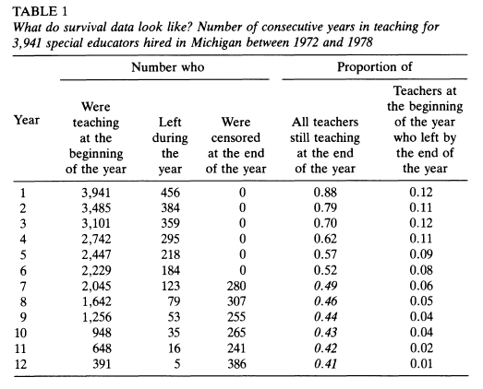
Collecting data for duration analysis
From the Willet and Singer readings

Slide 5
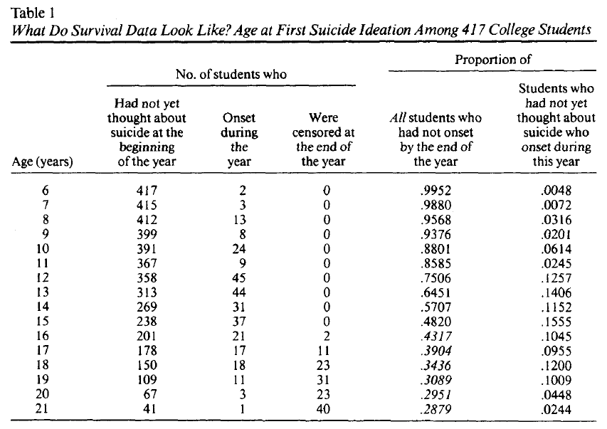
More duration data

Slide 6
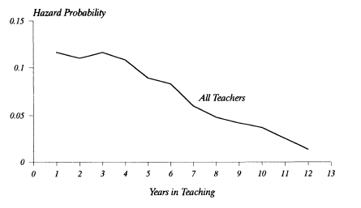
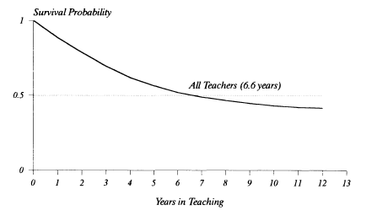

Instantaneous versus cumulative probabilities

Slide 7
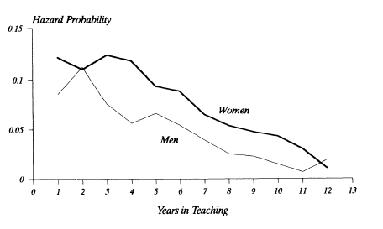
Building observed heterogeneity into the Hazard Model

Slide 8
Potential Issues
Left-censored data versus right-censored data
XXXX 1990 1991 1992 1993 XXXX XXXX
XXXX XXXX XXXX XXXX 1993 1994 1995
1989 1990 1991 1992 XXXX XXXX XXXX
Complete case
Right-censored
Left-censored

Slide 9
How do you define “effect size”?
Survival Probability
Effect Size

Slide 10
How do you define “effect size”?
Effect Size

Slide 11
Regression discontinuity and time series

Slide 12
Pay attention to the axis:
Regression Discontinuity
Time Series
Program
Program

Slide 13
Pay attention to the axis:
Regression Discontinuity
Time Series
Eligibility
Criteria
Time

Slide 14
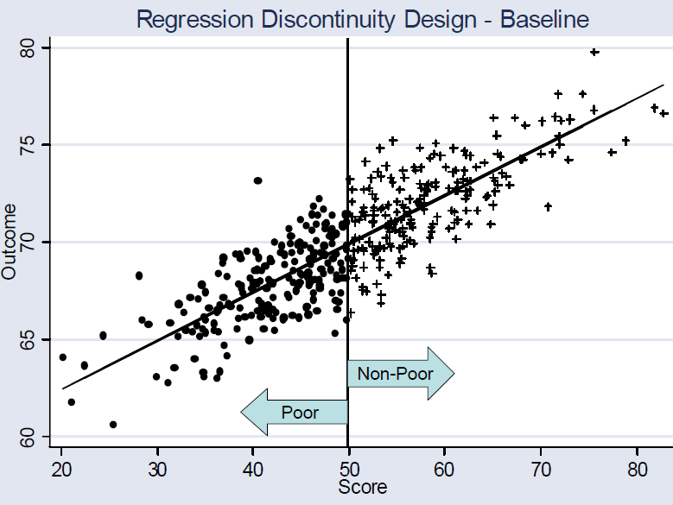
Regression discontinuity design
Source: Martinez, 2006, Course notes

Slide 15
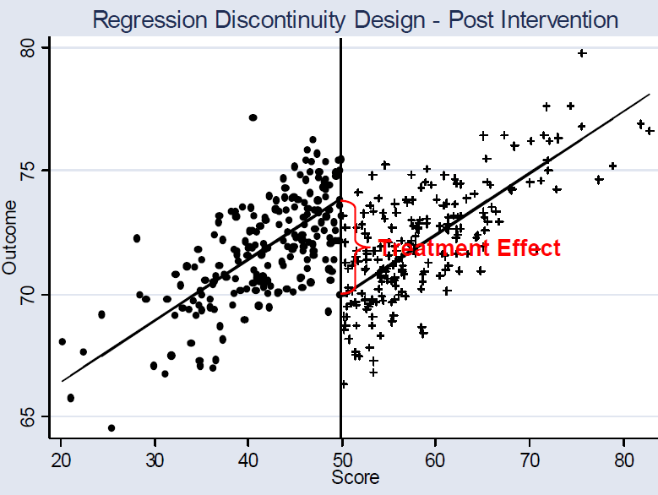
Regression Discontinuity

Slide 16
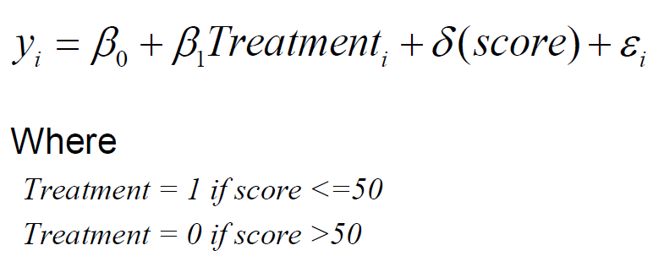
Regression Discontinuity Model

Slide 17
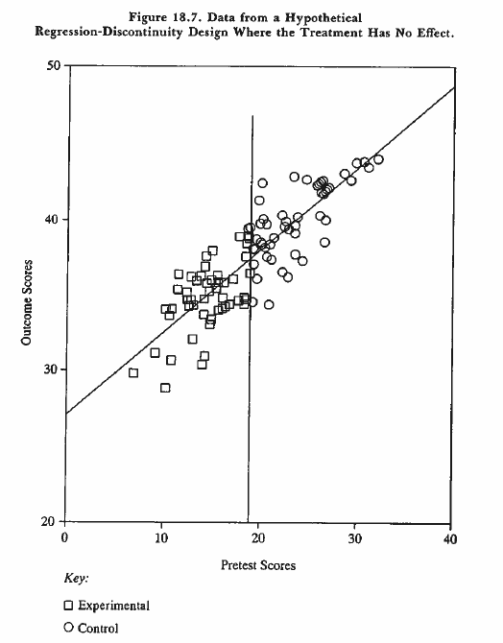
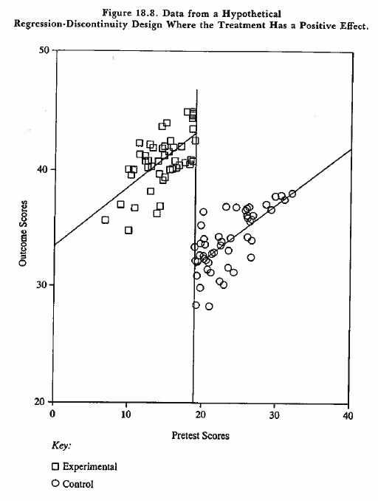
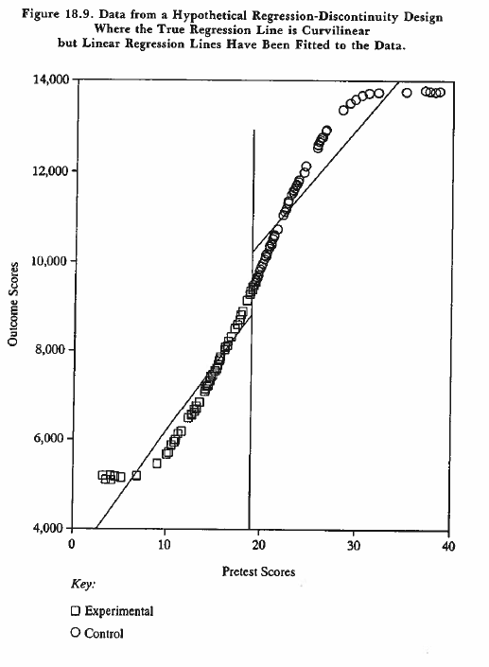
Problems with regression discontinuity

Slide 18
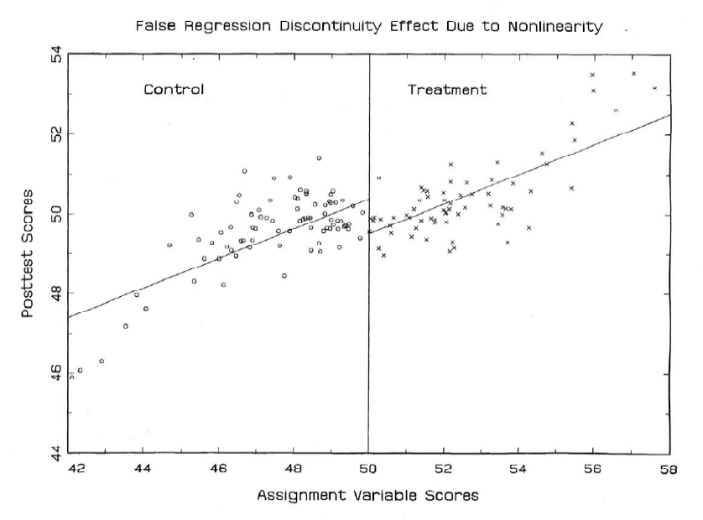
Another example of specification bias

Slide 19
Problems with fuzzy discontinuity:
Pre-treatment assignments
Outcome
Treatment
Control
Assessment
Score
Program
Criteria

Slide 20
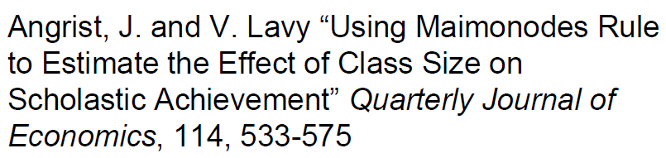
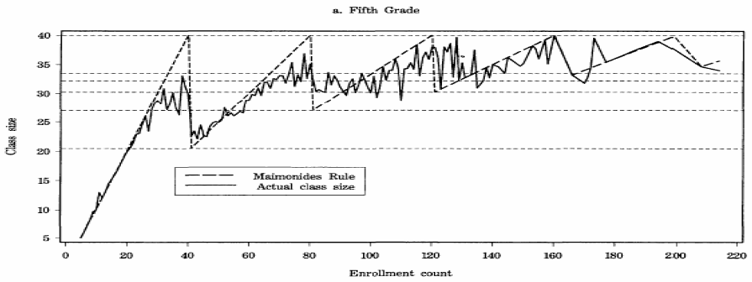
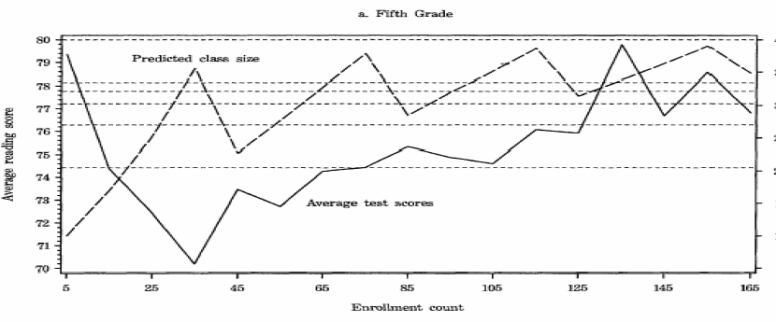
The fix?

Slide 21
How do you define “effect size”?

Slide 22
Time series

Slide 23
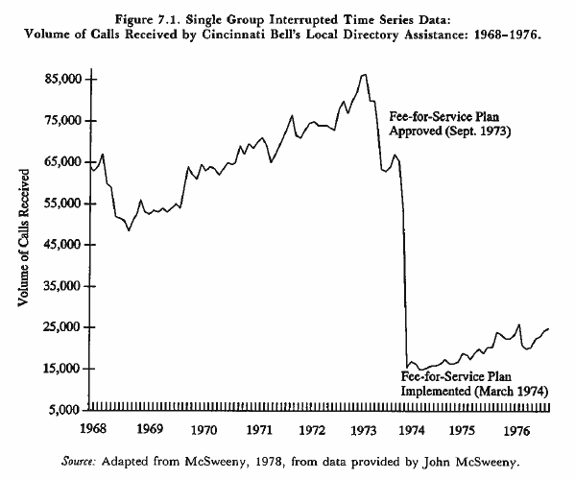
Interrupted Time Series

Slide 24
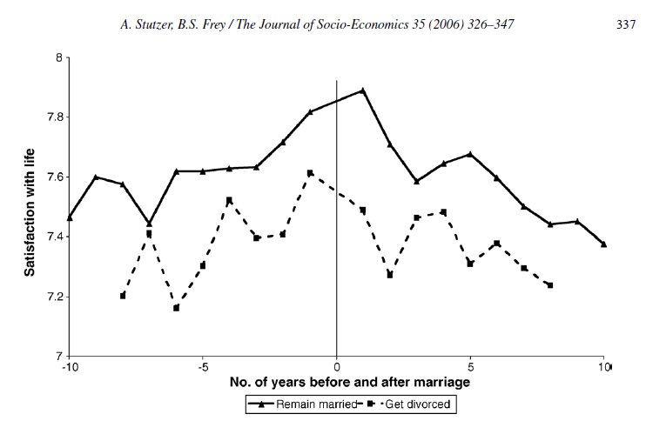
Time can be relative:

Slide 25
Interrupted Time Series Regression Models:
Y = outcome
T = time
D = dummy
P = time after program starts
Y | T | D | P
17 | 1 | 0 | 0
19 | 2 | 0 | 0
22 | 3 | 0 | 0
24 | 4 | 1 | 1
27 | 5 | 1 | 2
27 | 6 | 1 | 3
30 | 7 | 1 | 4

Slide 26
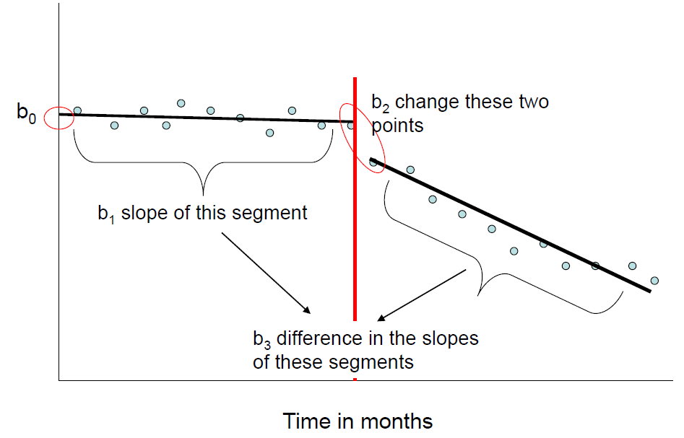
Interrupted Time Series
Regression Models:
Y | T | D | P
17 | 1 | 0 | 0
19 | 2 | 0 | 0
22 | 3 | 0 | 0
24 | 4 | 1 | 1
27 | 5 | 1 | 2
27 | 6 | 1 | 3
30 | 7 | 1 | 4

Slide 27
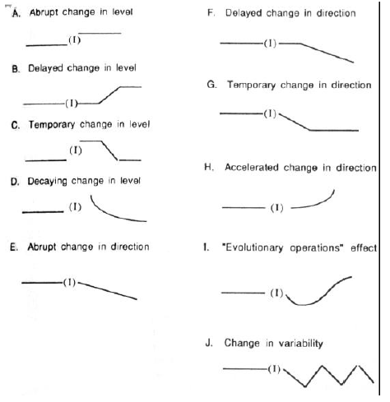
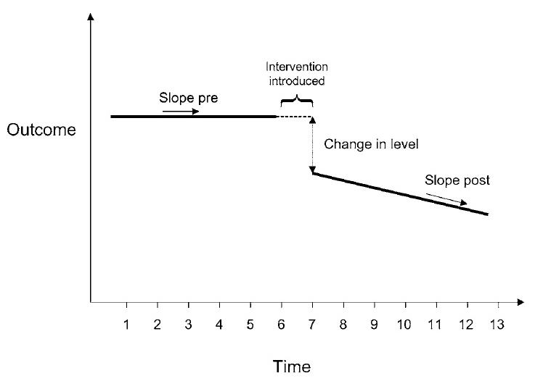
Treatment effects can be nuanced:

Slide 28
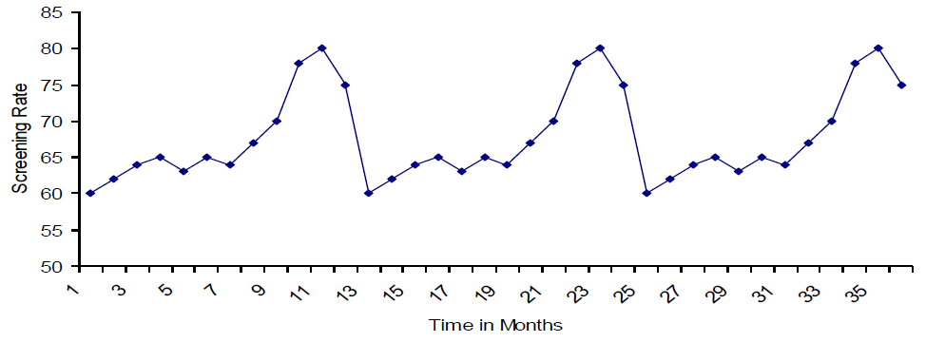
Possible Issues?
History
Contamination
Attrition
Seasonality

Slide 29
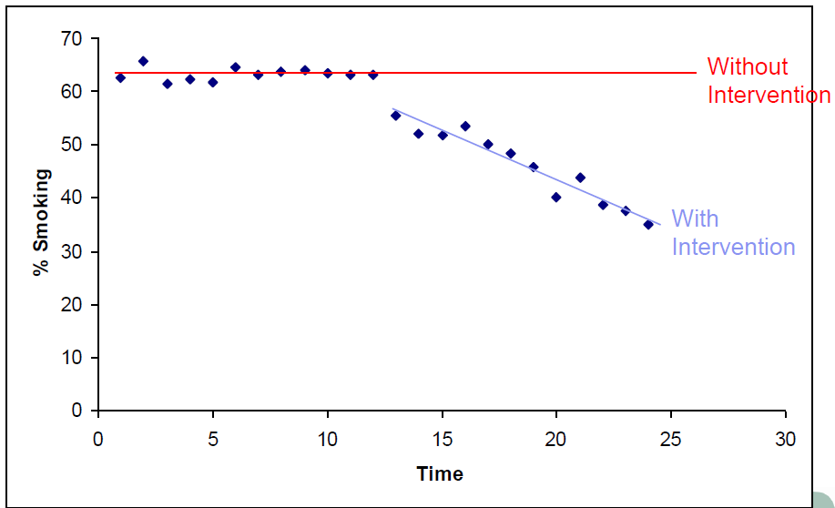
Strengthening the design: adding a comparison group

Slide 30
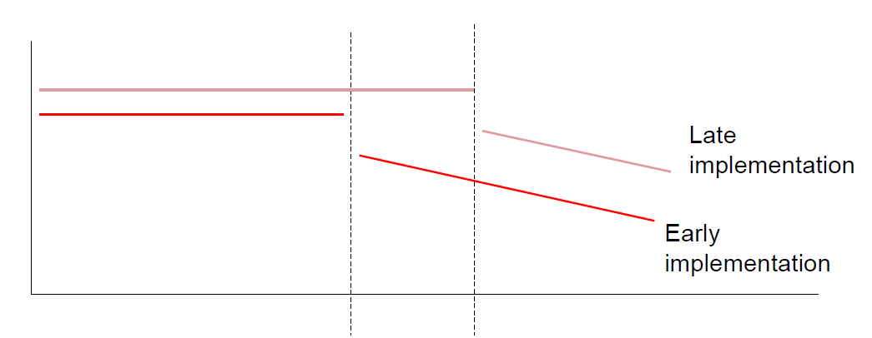
Strengthening Design:
Implementation Phases

Slide 31
How do you define “effect size”?

