Slide 1
Health
LECTURE 03
Lecy ∙ Urban Policy

Slide 2
Outline for today:
Cities case study assignment
Health in the urban environment
Lab 02 – Load a Base Map

Slide 3
Frumkin, H., Frank, L., & Jackson, R. J. (2004). Urban sprawl and public health, CH9: Social Capital and Sprawl. CH5: Physical Activity, Sprawl and Health. CH6: Injuries and Deaths from Traffic.
What are the two primary types of social capital? (p 163)
What is the relationship between social capital and longevity? (pp 166-167)
What is the relationship between sprawl and social capital? (pp 171-180)
What is the relationship between inequality and social capital? (pp 180-184)
What are some of the determinants of physical activity? (p 99)
What is the relationship between the age of houses and physical activity? (p 101)
What are the limits to what we know about improving physical activity? (pp 105-107)
What is the leading cause of death for those between ages of 1 and 24? (p 110)
What is the characteristic of street design most strongly associated with automobile crashes? (p 111)
Is a mile of walking more or less dangerous than a mile of driving? (p113)
What is the relationship between the proportion of people that travel by foot / bike and pedestrian or biker fatality rates? (p 120)
What is a bigger risk – dying from a car accident in suburb or being murdered in the inner city? (pp 121-122)

Slide 4
Duany, A., Plater-Zyberk, E., & Speck, J. (2001). Suburban nation: The rise of sprawl and the decline of the American dream. Macmillan. CH7: The Victims of Sprawl.
Name at least three victims of sprawl.
One page 127 the authors tell the story of Franklin, a suburb outside of Milwaukee. What is the tax challenge they face? And what is the cause?
Chakrabarti, A Country of Cities, CH3: Cities, Health and Joy.
Chakrabarti mentions at least five health / crime indicators that vary between urban spaces and their suburbs. What are they?

Slide 5
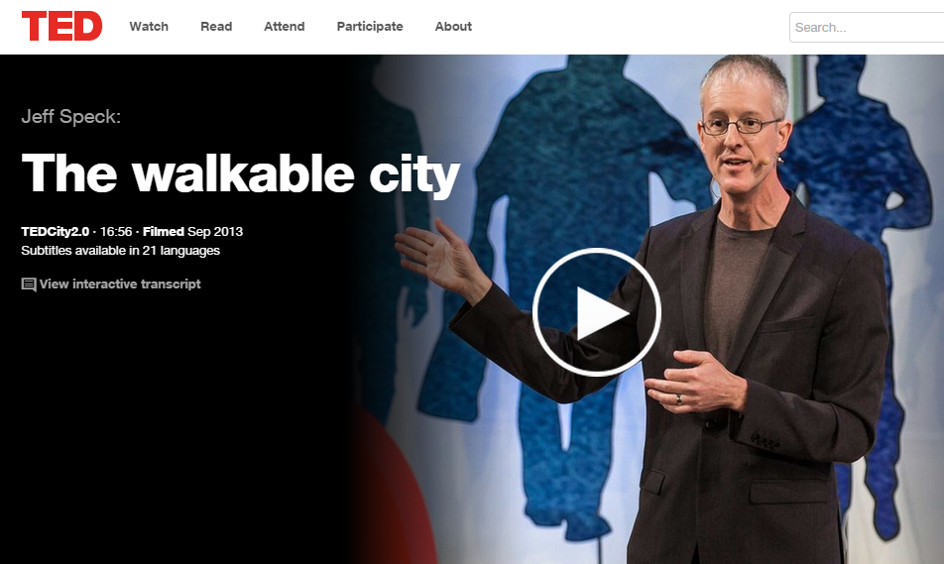

Slide 6
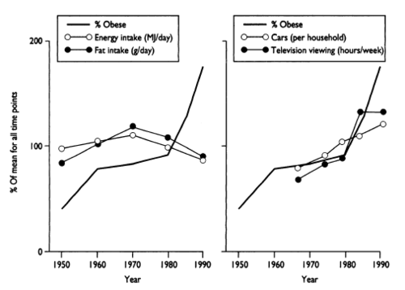
Gluttony vs sloth:

Slide 7
Investment riches built on subprime auto loans to poor
By MICHAEL CORKERY and JESSICA SILVER-GREENBERG JANUARY 26, 2015
http://dealbook.nytimes.com/2015/01/26/investment-riches-built-on-auto-loans-to-poor/
A Bet on Car Dependence
Mandy Gray of Boiling Springs, Pa., is unemployed and depends largely on her partner’s $11-an-hour salary as a forklift operator. She says she has struggled to keep up with the $306 monthly payments on her Santander auto loan.
A lot is at stake not only for Ms. Gray, but for Santander Consumer.
The calculation by the lender is that Ms. Gray and thousands of other troubled borrowers will go to great lengths to keep their cars.
It is a reasonable wager.
Or in the words of a Santander Consumer investor, “You can sleep in your car, but you can’t drive your house to work.”
For decades, even during rocky economic times, defaults on cars loans have remained relatively low.
In March, Ms. Gray, 35, received a $13,426.64 auto loan from Fifth Third Bank with a 17.72 percent interest rate. She bought a 2009 Hyundai. But five days later, Santander Consumer told her that her loan was “now owned by Santander Consumer,” according to a letter from the lender reviewed by The Times. Ms. Gray, who has been taking online college courses, says she plans to use her financial aid money to catch up on missed car payments.
Americans are so dependent on their cars that investors are betting that they would rather lose their home to foreclosure than their car to repossession.

Slide 8
Social capital

Slide 9
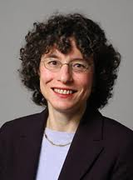
Regional Advantage: Silicon Valley vs Route 128
For example, engineers and other professionals in Silicon Valley often changed firms or quit their jobs to start firms of their own, and such decisions enjoyed widespread support. In Massachusetts, leaving one firm for another, much less for a startup, was infrequent and frowned upon as disloyal. Silicon Valley firms collaborated with one another in formal and informal ways, developing alliances, contracting for components and services, or simply sharing information. Employees of different firms mixed frequently at local business and social gatherings. In contrast, Massachusetts firms were highly secretive and self- contained, and employees had fewer interfirm contacts. Boundaries among firms were blurred in California but sharply etched in Massachusetts.
These different industrial systems, Saxenian shows, affected the rate of new start-ups and time-to-market for new products. From decade to decade, start-up rates rose in Silicon Valley but fell along Route 128. It was easier for new Silicon Valley firms to find venture capital, professional talent, and technical services from an unmatched regional base of vendors. The fluidity of the system enabled people with innovative ideas to develop them and bring them to market more quickly.
AnnaLee Saxenian
http://www.princeton.edu/~starr/saxerev.html

Slide 10
The role of proximity in innovation
Howells, J. R. (2002). Tacit Knowledge, Innovation and Economic Geography. Urban Studies, 39(5-6), 871-884.
The studies dedicated to innovation proved that innovation and knowledge capital are highly concentrated in a minority of urban regions. It is established that essential elements of the innovation became regionalised and proximity boosts the occurrence of innovation (Doloreux/Parto 2005). Simmie (2003) believes that the reasons for this are tacit knowledge and experiences which are concentrated in a particular place and have low mobility. Sharing them requires socials networks.

Slide 11
Why Some Communities Foster More Entrepreneurs Than Others Richard Florida, Atlanta Cities, December 2013
New research shows there's clearly more to the story than just individual skill, pluck, and ambition. The study, by Temple University’s Seok-Woo Kwon, the University of Missouri’s Colleen Heflin, and Duke University’s Martin Ruef, examines the relationship between self-employment levels and community support structures across America’s metro areas. Published in the December issue of the American Sociological Review, the authors argue that the strength of local social networks and trust — using the term “social capital,” popularized by Harvard sociologist Robert Putnam — plays a major role in whether a city is able to foster a culture of self-employment and entrepreneurship.
Social trust in general can help entrepreneurs and small businesses establish the kind of reputation required to secure financing, attract employees and customers, and build a viable business. Membership in local community organizations, one of the hallmarks of high-social capital communities, is particularly important, putting members in touch with an ever-wider social network. In one of their models, in fact, they found that high levels of membership in communal organizations could, all else being equal, more than double the amount of self-employment. With these personalized connections, smaller businesses could flourish.
When it comes to entrepreneurship, social capital can be a double-edged sword. It can provide networks of relationships and connections that help entrepreneurs get off the ground. But on the flip side, it can also mean that similar people engage with similar people, stifling the diversity of social connections that entrepreneurs need to succeed. My own research has found that communities rich in social capital tend to have lower rates of high-tech innovation, while innovation and entrepreneurship tend to thrive in more diverse communities with lower levels of social capital. The kind of social capital that is truly essential to innovation and entrepreneurship tends to be bridging (occurring across groups) as opposed to bonding (occurring within insular communities).

Slide 12
Social determinants of health
World Health Organization: The Health Impact Assessment 2010. http://www.who.int/hia/en/
There's good reason for fixing health care to be a priority in the U.S., but a burgeoning school of thought suggests that access to care can turn out to matter less, in terms of overall health, than we're apt to assume. "There are broader contextual factors in communities that are definitely driving health outcomes more" than access to care, says Jason Purnell, PhD, MPH, an assistant professor at Washington University's Brown School. "That understanding seemed to have been missing from the survey results." The World Health Organization insists, "to a large extent, factors such as where we live, the state of our environment, genetics, our income and education level, and our relationships with friends and family all have considerable impacts on health, whereas the more commonly considered factors such as access and use of health care services often have less of an impact."

Slide 13
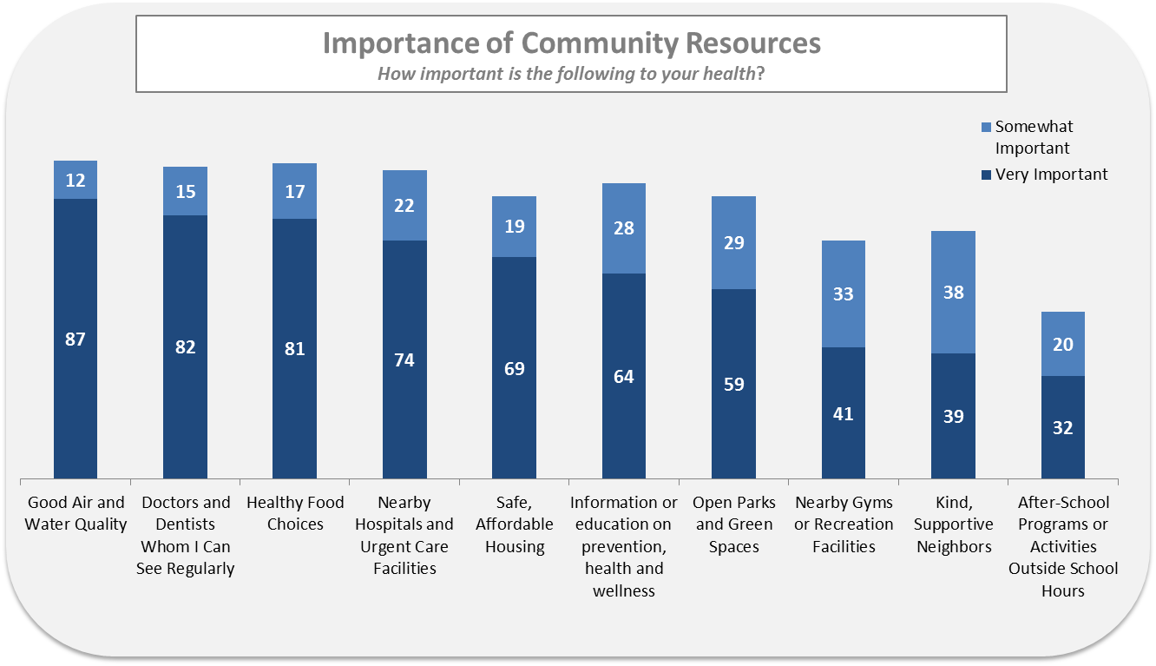
http://www.citylab.com/politics/2013/03/how-decline-communities-explains-americas-health-problems/4889/

Slide 14
Social capital and long life
“Social participation and health in a community rich in stock of social capital.”
Journal of Health Education Research
In Finland, members of the Swedish‐speaking minority, many of whom live in the province of Ostrobothnia, intermingle with the Finnish‐speaking majority. Although the two language communities are quite similar to each other in most societal respects, including socioeconomic status, education and use of health services, significant disparities have been reported in the morbidity, disability and mortality between the Swedish‐speaking minority and the Finnish‐speaking majority. Since the population genetic, ecological and socioeconomic circumstances are equal, Swedish speakers’ longer active life is difficult to explain by conventional health‐related risk factors. A great deal of health inequality (between the language groups) seems to derive from uneven distribution of social capital, i.e. the Swedish‐speaking community holds a higher amount of social capital that is associated with their well‐being and health. Factor analysis revealed four patterns of social capital measures, i.e. voluntary associational activity, friendship network, religious involvement and hobby club activity, of which associational activity, friendship network and religious involvement were significantly associated with good self‐rated health. Also, trustful friendship network, hobby club activity and religious involvement as well as avoidance of intoxication‐prone drinking behavior were significantly more frequent among the individuals of the Swedish‐speaking community. We suggest that health promotion should seek ways of working which would encourage social participation.

Slide 15
Why some rural places prosper and others do not
Published in International Regional Sciences Review
Andrew M. Isserman
Edward Feser
Drake E. Warren
More than 300 rural counties are more prosperous than the nation. Each has lower unemployment rates, lower poverty rates, lower school dropout rates, and better housing conditions than the national averages. Prosperous counties tend to have more educated populations, more diverse economies, more private non-farm jobs, more farmers and government farm payments, more creative class occupations, and more equal income distributions. They have fewer African-American, American Indian, or Hispanic residents and fewer recent immigrants. Some findings support what many rural people believe to be true: civically engaged religious groups and other identities that bind people together can really matter. Other results contradict conventional wisdom. For instance, climate and distances to cities and major airports, are relatively unimportant. Focusing on prosperity, instead of growth or competitiveness, provides new insights into rural conditions and prospects.

Slide 16
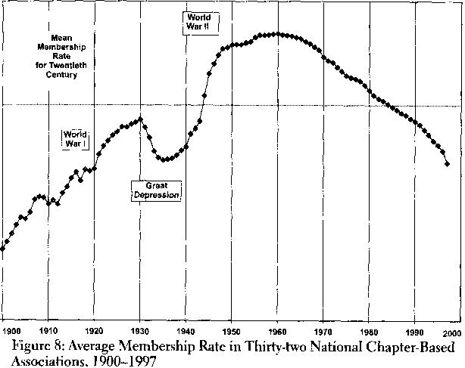
Putnam: the decline of social capital

Slide 17
Parks!

Slide 18
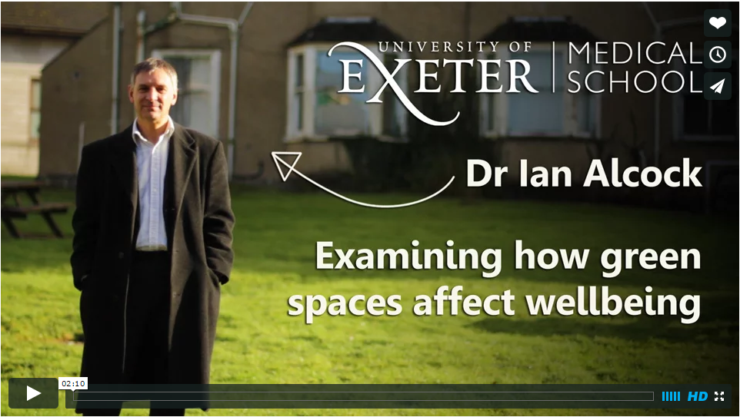
Parks!
Green space in towns and cities could lead to significant and sustained improvements in mental health, finds a new study published in the journal of Environmental Science & Technology

Slide 19
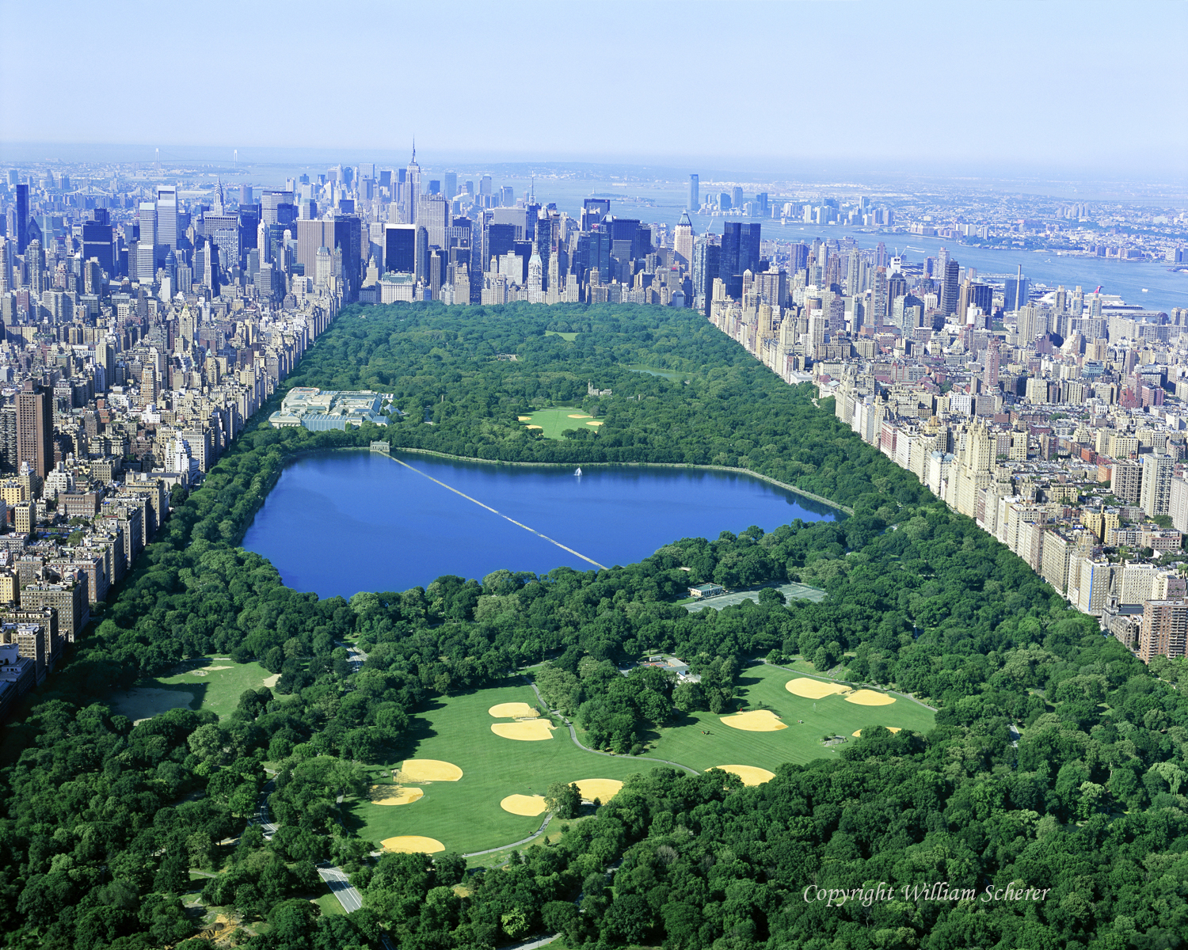
Parks are great, but if your city was not designed around one, what can it do?

Slide 20
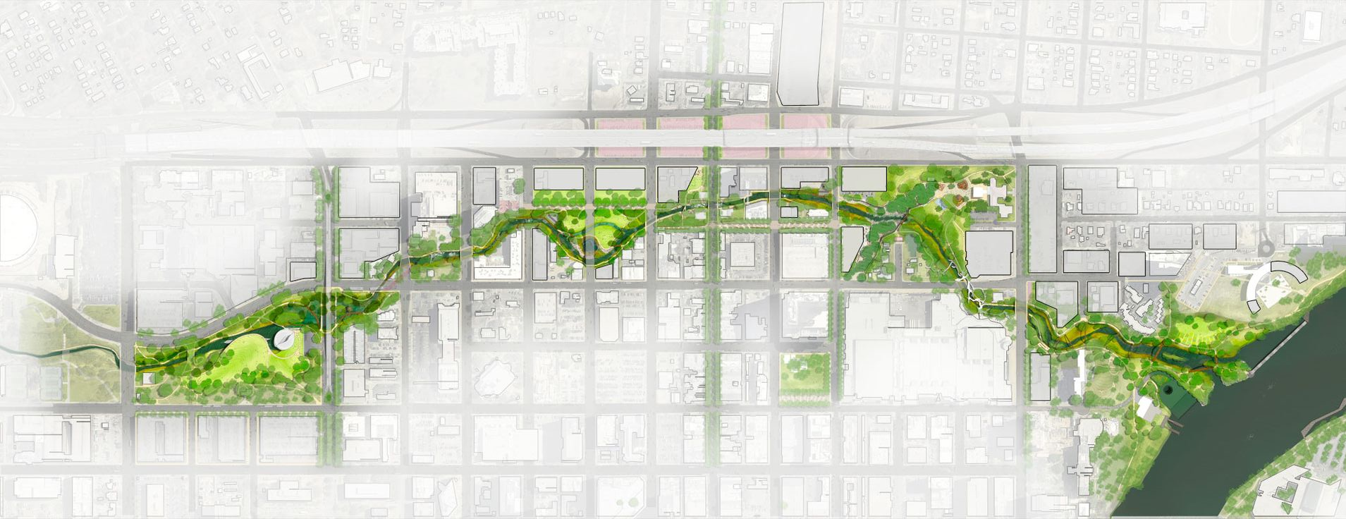
Connecting pocket parks makes cities coherent
Austin, TX
http://www.mvvainc.com/project.php?id=99&c=urban_design

Slide 21
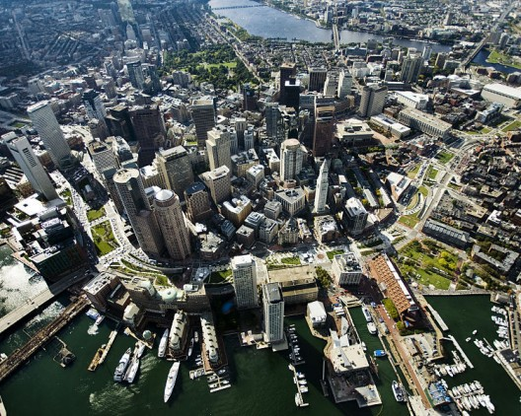
Linear parks offer more benefits than the same park space arranged as a square.
They are often created by converting an old rail track or following a natural easement like a creek.

Slide 22
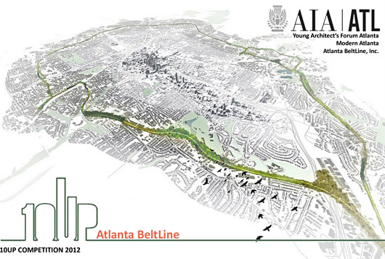

Slide 23
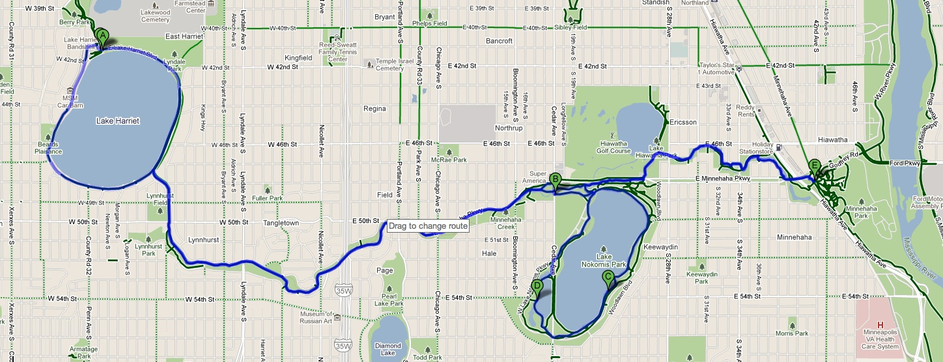
Minneapolis, MN

Slide 24
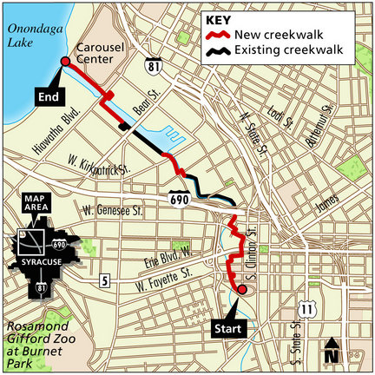

Slide 25
Big picture

Slide 26
Parks
Physical Activity
Disease (obesity, heart disease, diabetes)
Walkability
Safety
Social Capital
Sprawl
Innovation / Economic Development
Commute Time

Slide 27
-
+
Commute Time
Physical Activity
Health

Slide 28
Commute Time
Innovation
Sprawl
Social Capital
Walkability
Physical Activity
Disease
Parks
Safety

Slide 29
Commute Time
Innovation
DENSITY
Social Capital
Walkability
Physical Activity
Disease
Parks
Safety

Slide 30
What are the policy mechanisms here?
Commute Time
Innovation
Sprawl
Social Capital
Walkability
Physical Activity
Disease
Parks
Safety

Slide 31
Some Policy tools we will cover:
Tax Increment Financing (TIFs)
Tax credits / breaks
Mortgage interest rate deductions
Gasoline tax
Community Block Grants
Federal transportation grants
New Market Tax Credits
Local Initiatives Support Corporation (LISC)
Low Income Housing Tax Credits
Public private partnerships / ventures
Community Development Financial Institutions

Slide 32
Example question for final exam:
Using the list of policy tools that we have covered in this class, discuss how you would create an innovation district in Syracuse?

Slide 33
interventions

Slide 34
Three ways to influence Physical activity:
Frumkin, H., Frank, L., & Jackson, R. J. (2004). Urban sprawl and public health, CH9: Social Capital and Sprawl. CH5: Physical Activity, Sprawl and Health. CH6: Injuries and Deaths from Traffic. p. 99
Land use patterns (planning)
Design characteristics (walkability)
Transportation

Slide 35
Adding sidewalks
Gunn, L. D., Lee, Y., Geelhoed, E., Shiell, A., & Giles-Corti, B. (2014). The cost-effectiveness of installing sidewalks to increase levels of transport-walking and health. Preventive medicine, 67, 322-329.
A positive relationship was found between the presence of sidewalks and transport-walking for both transport-walking thresholds of 150 and 60 min/week. The minimum intervention was found to be the most cost-effective at $2330/person and $674/person for the 150 and 60 min/week transport-walking thresholds respectively. Increasing the proportion of people transport-walking and increasing population density by 50% improved the cost-effectiveness of installing side-walks to $346/person.

Slide 36
Relocation
Hirsch, J. A., Diez Roux, A. V., Moore, K. A., Evenson, K. R., & Rodriguez, D. A. (2014). Change in Walking and Body Mass Index Following Residential Relocation: The Multi-Ethnic Study of Atherosclerosis. American journal of public health, 104(3), e49-e56.
Moving to a location with a 10-point higher Walk Score was associated with a 16.04 minutes per week (95% confidence interval [CI] = 5.13, 29.96) increase in transport walking, 11% higher odds of meeting Every Body Walk! goals through transport walking (adjusted odds ratio = 1.11; 95% CI = 1.02, 1.21), and a 0.06 kilogram per meters squared (95% CI = −0.12, −0.01) reduction in BMI. Change in walkability was not associated with change in leisure walking.

Slide 37
Change street design
Marshall, W. E., Piatkowski, D. P., & Garrick, N. W. (2014). Community design, street networks, and public health. Journal of Transport & Health, 1(4), 326-340.
The results suggest that more compact and connected street networks with fewer lanes on the major roads are correlated with reduced rates of obesity, diabetes, high blood pressure, and heart disease among residents. Given the cross-sectional nature of our study, proving causation is not feasible but should be examined in future research. Nevertheless, the outcome is a novel assessment of streets networks and public health that has not yet been seen but will be of benefit to planners and policy-makers.

Slide 38
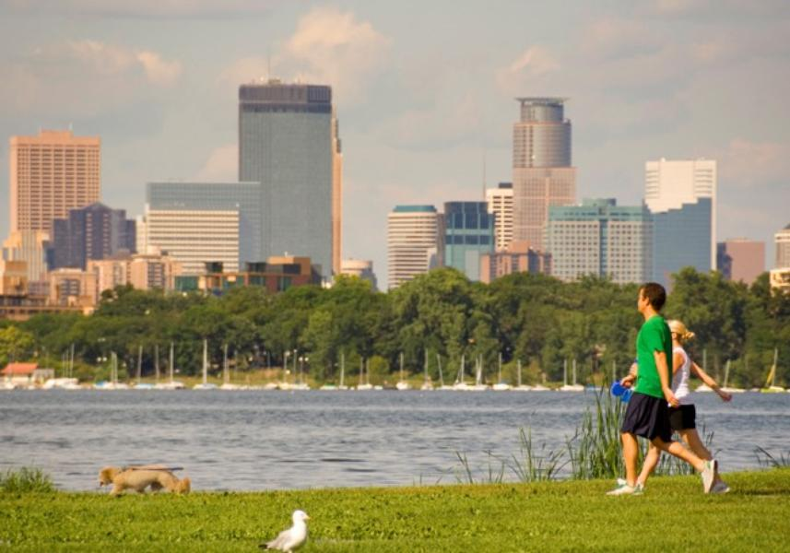
Forbes: top 20 healthy cities
#1 Minneapolis, Minn.
Minneapolis residents breathe clean air, prioritize exercise and keep their weight down, supported by a city that was among the first to add bike trails and ban smoking in public places. If you live in Minneapolis-St. Paul, you and your neighbors are less likely to have cardiovascular disease, diabetes, and asthma and are more likely to be in excellent or very good health. (It helps that you're less likely to smoke and more likely to walk or bike to work -- in the summer, at least).
http://www.forbes.com/pictures/eigl45hfh/1-minneapolis-minn/

Slide 39
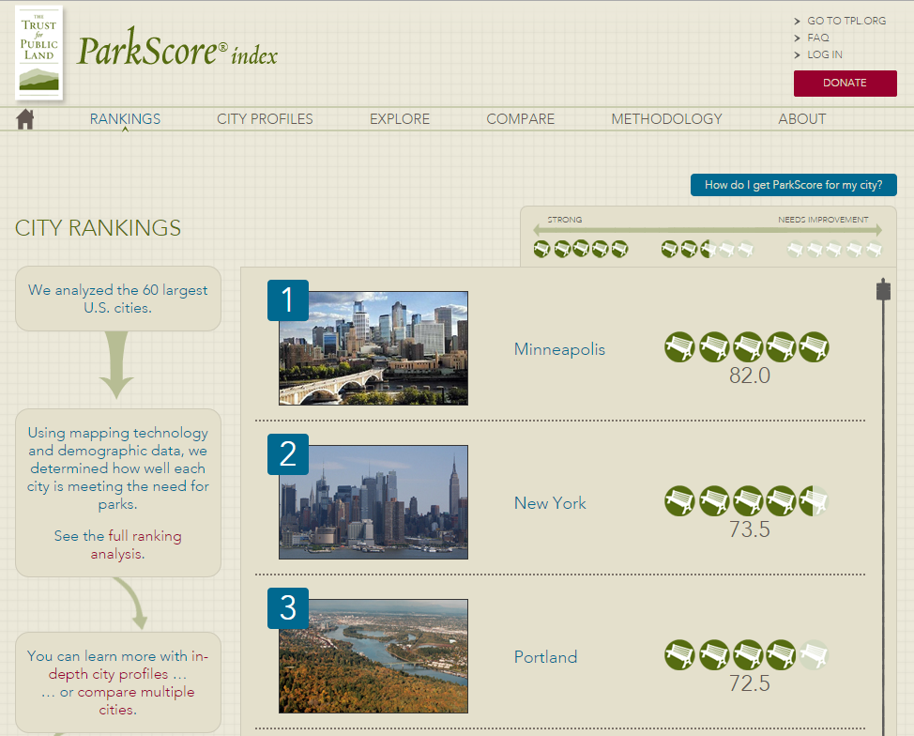
No surprise Minneapolis has the most park density per capita in the country

Slide 40
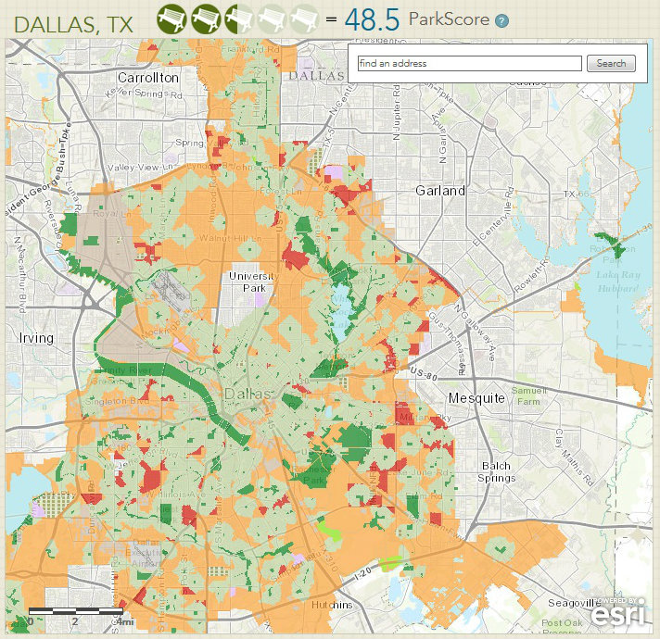
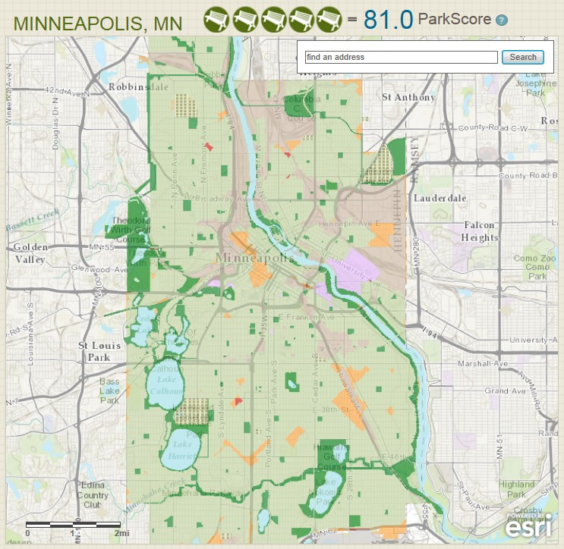
Normal City
Super Park Access

Slide 41
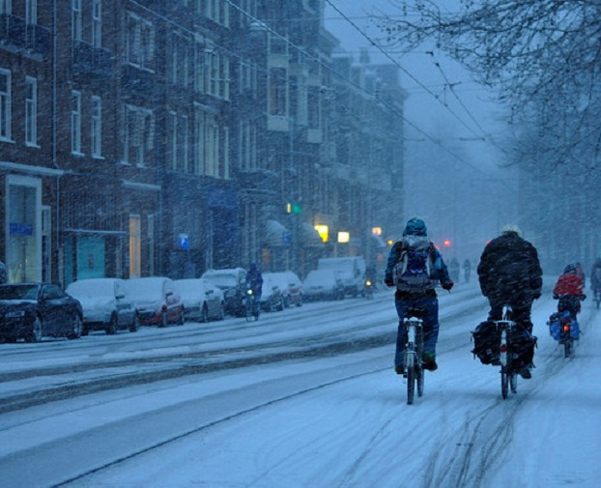
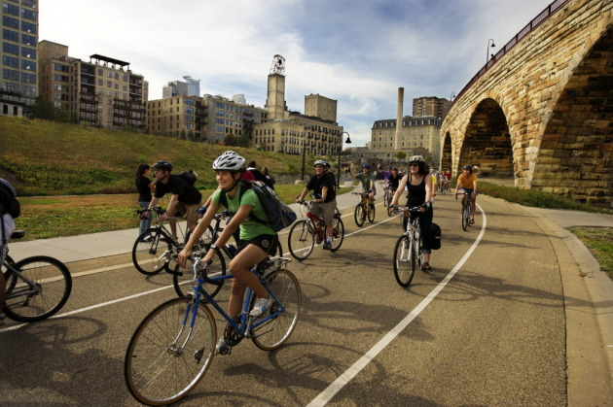

Slide 42
Health
Inequality

Slide 43
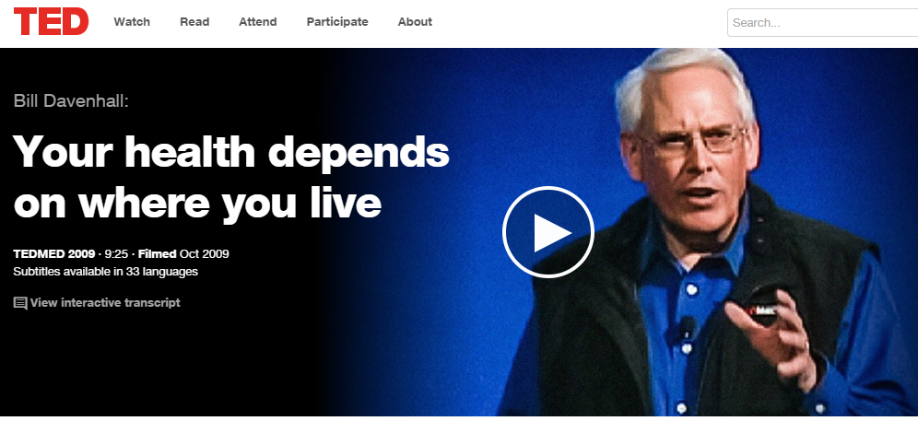
Where you live: It impacts your health as much as diet and genes do, but it's not part of your medical records. At TEDMED, Bill Davenhall shows how overlooked government geo-data (from local heart-attack rates to toxic dumpsite info) can mesh with mobile GPS apps to keep doctors in the loop. Call it "geo-medicine."

Slide 44
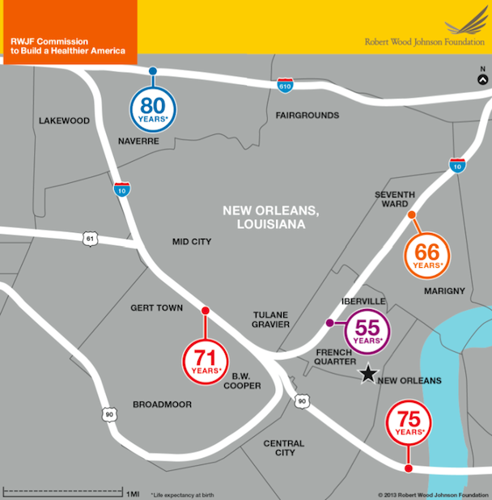
http://www.citylab.com/housing/2013/07/we-need-start-treating-americas-poorest-neighborhoods-developing-countries/6189/

Slide 45
Social determinants of health
World Health Organization: The Health Impact Assessment 2010. http://www.who.int/hia/en/
There's good reason for fixing health care to be a priority in the U.S., but a burgeoning school of thought suggests that access to care can turn out to matter less, in terms of overall health, than we're apt to assume. "There are broader contextual factors in communities that are definitely driving health outcomes more" than access to care, says Jason Purnell, PhD, MPH, an assistant professor at Washington University's Brown School. "That understanding seemed to have been missing from the survey results." The World Health Organization insists, "to a large extent, factors such as where we live, the state of our environment, genetics, our income and education level, and our relationships with friends and family all have considerable impacts on health, whereas the more commonly considered factors such as access and use of health care services often have less of an impact."

Slide 46
https://www.youtube.com/watch?v=eYG0ZuTv5rs
Start 27:45

Slide 47
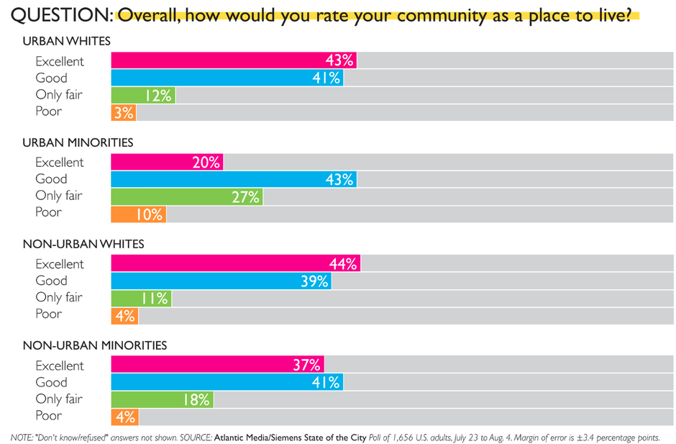
Whites fair similarly in cities or suburbs. Minorities are happier in suburbs.

Slide 48
In
SUMMARY

Slide 49
Summary of main points
Sprawl diminishes physical activity.
Lower physical activity leads to obesity and onset of disease.
Sprawl decreases social capital.
Parks improve mental and physical health.
There are some interventions for health, but they are hard.
Huge health disparities exist within cities.

