Slide 1
Lab 03
Background on Census Data Conventions

Slide 2
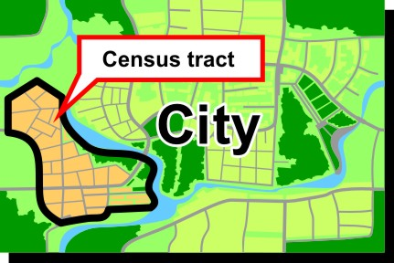
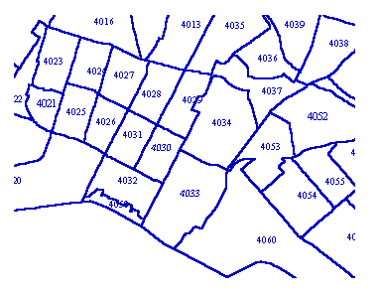
In the U.S., Census tracts are "Designed to be relatively homogeneous units with respect to population characteristics, economic status, and living conditions, census tracts average about 4,000 inhabitants."
Why are the tracts different sizes?

Slide 3
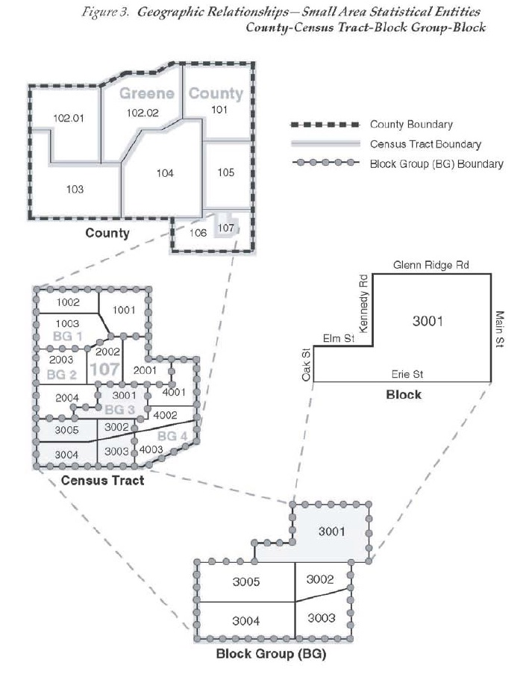
Nested Administrative Units
States
Counties
Census Tracts
Census Blocks
Census Tract is usually the most granular level of data provided by census
County
Census Tract
Block
Block Group

Slide 4
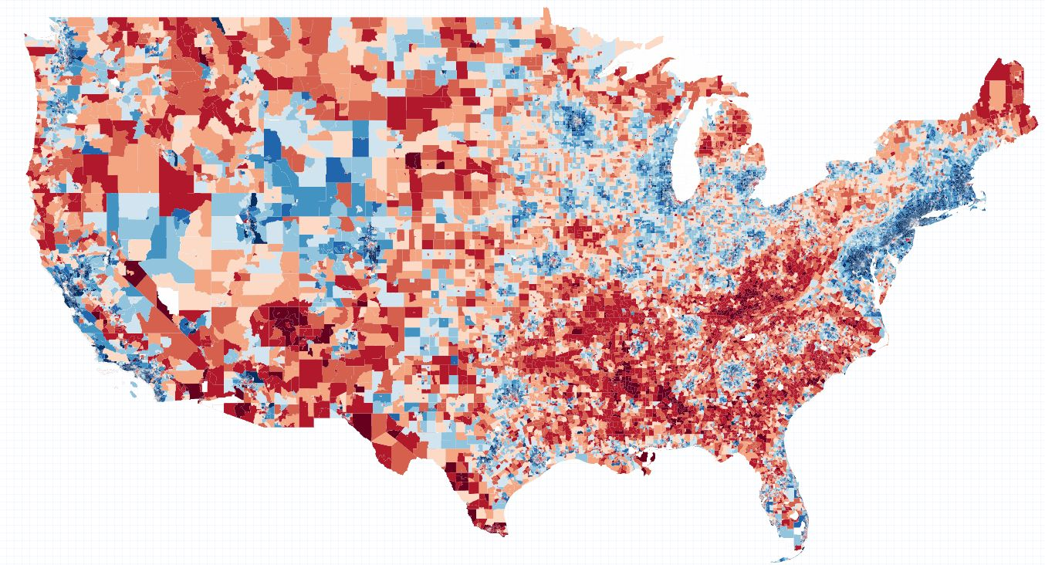
Example: Household Income by Census Tract

Slide 5
FIPS Code Structure
11-digit Geo ID Code
42003000102
42-003-0001.02
State
County
Census Tract

Slide 6
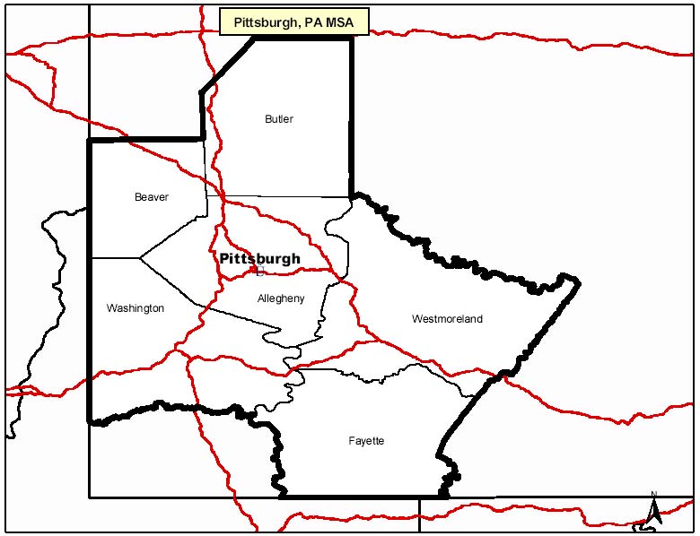
Which counties are in my MSA?
http://www.bea.gov/faq/index.cfm?faq_id=470
Pittsburgh, PA (Metropolitan Statistical Area)
Allegheny, PA [42003]
Beaver, PA [42007]
Butler, PA [42019]
Fayette, PA [42051]
Washington, PA [42125]
Westmoreland, PA [42129]
FIPS Code for Allegheny County (42003)
42 = Pennsylvania
003 = Allegheny County

Slide 7
American Community Survey
The American Community Survey (ACS) is an ongoing statistical survey by the U.S. Census Bureau, sent to approximately 250,000 addresses monthly (or 3 million per year). It regularly gathers information previously contained only in the long form of the decennial census. It is the largest survey other than the decennial census that the Census Bureau administers.
Note: What is the difference between 1 year, 3 year, 5 year?

Slide 8
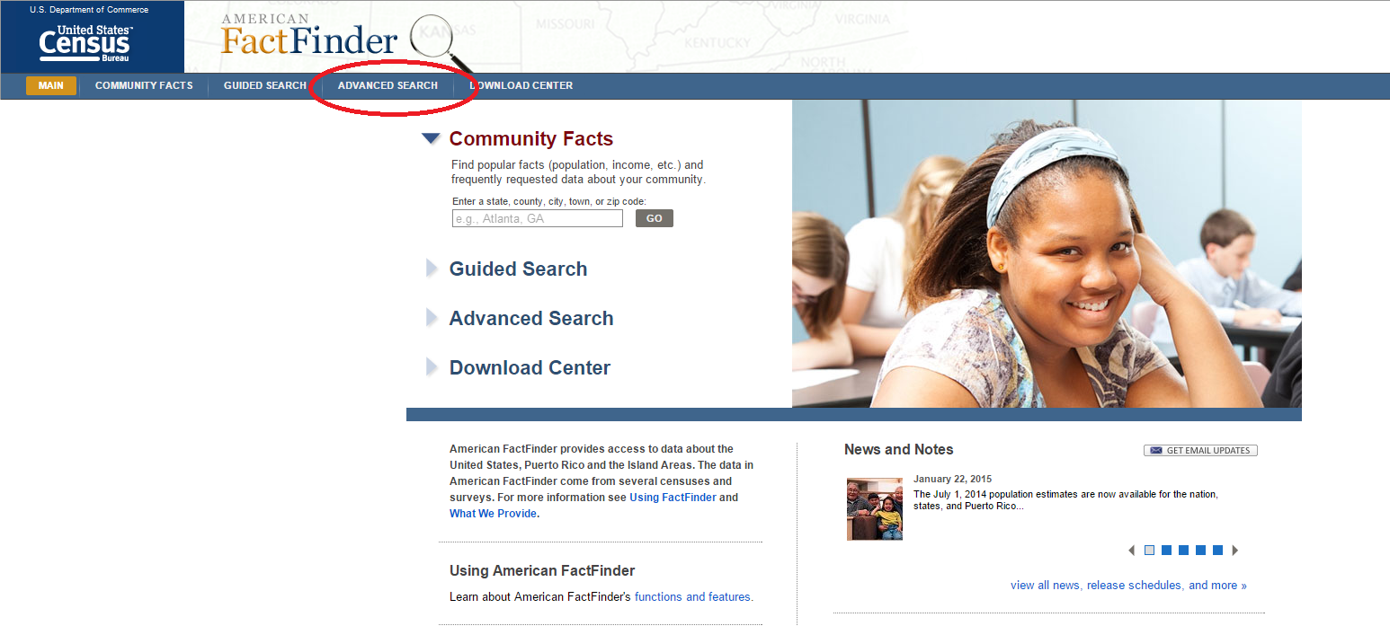
http://factfinder.census.gov/faces/nav/jsf/pages/index.xhtml

